Slide 1

NSG Pilkington – University of Liverpool Machine Learning Project: 16/06/2021
Dr. Peter Green
Diego Echeverria
Sarini Jayasinghe
Risk Institute,
School of Engineering

Slide 2
Today
Content:
ISRA 5D Scanner Data
GP inputs & test data
PCA with random inputs
Upskilling:
Linear regression
How do we learn ‘online’?
What actually is a Neural Network?
What is a Gaussian Process?
How does PCA work?
Shannon Entropy

Slide 3
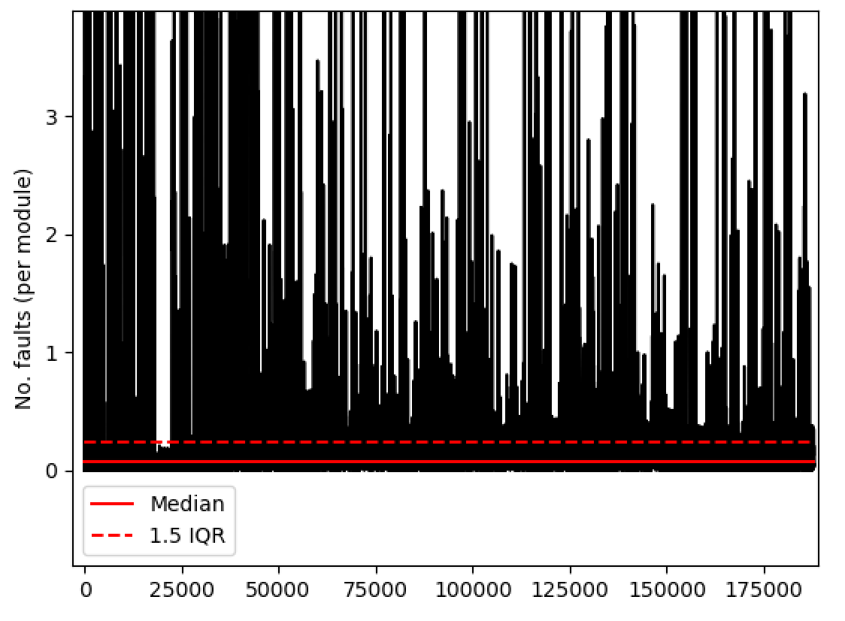
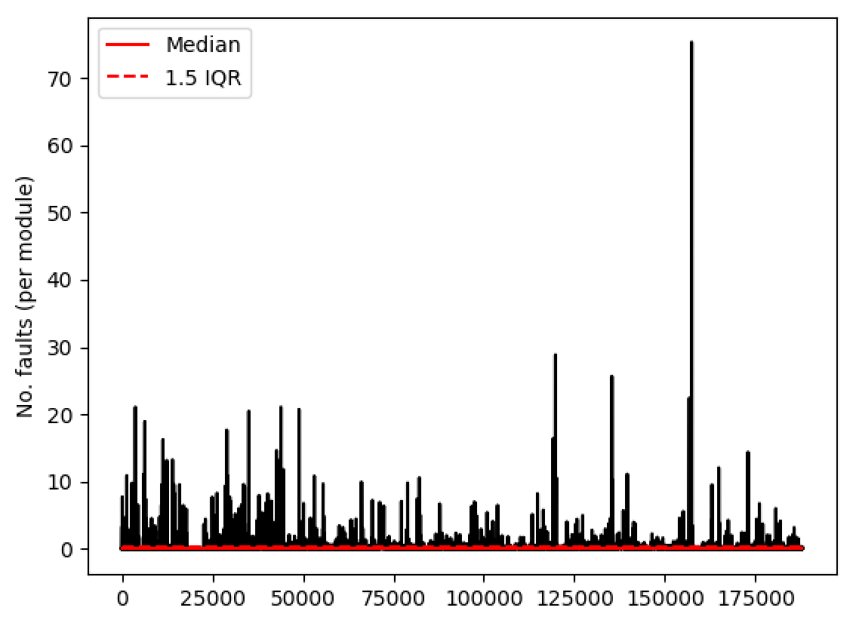
ISRA 5D
Have concatenated all of the individual module readings into a single long array.
Standard (robust) definition of an outlier (median + 1.5IQR) will exclude a lot of data.
Results are probably skewed by, for example, modules 0 and 4 (which are mostly zeros).
Have adopted a module-by-module approach instead.

Slide 4
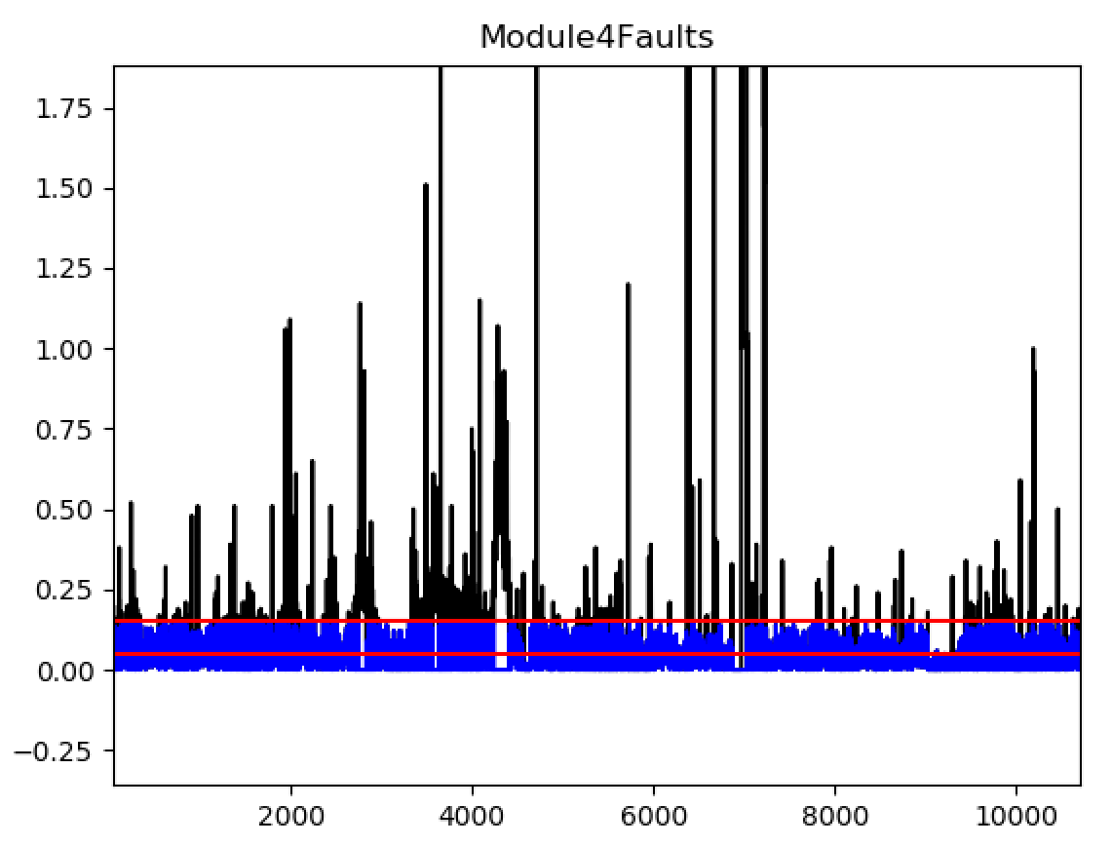
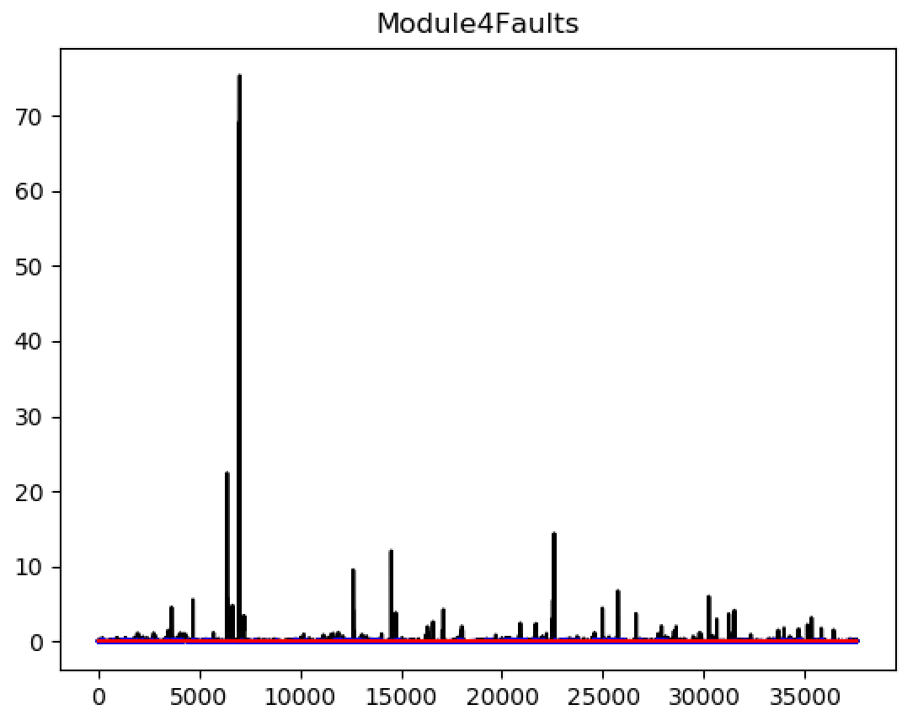
ISRA 5D
Even just looking at individual modules we are still removing a lot of data.
Tried to remove fault density values that are equal to zero before calculating signal statistics but this didn’t make much difference.

Slide 5
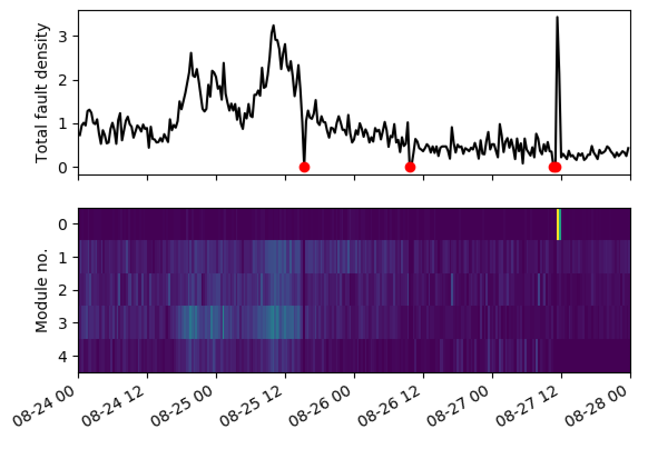
ISRA 5D
These dips are all equal to zero, so easy to identify
Module no. now correct (was the wrong way around in the previous presentation)
Now plotted against date time

Slide 6
ISRA 5D
Clearly these two readings are different – the first looks real while the second looks like something we should ignore. Similar magnitudes but the second is less uniformly distributed across the ribbon.

Slide 7
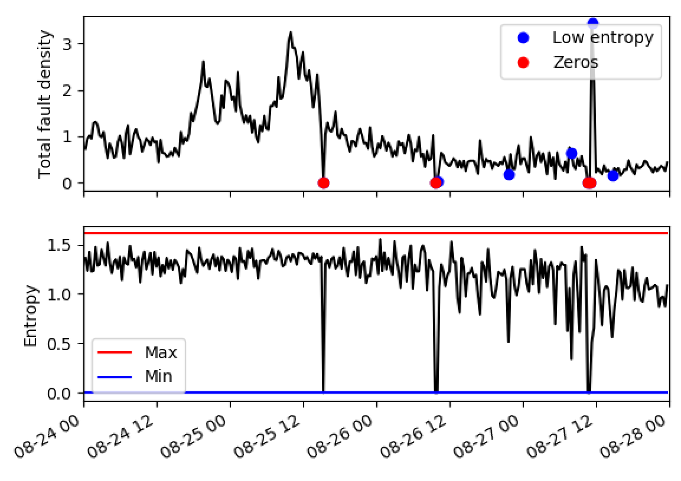
ISRA 5D
Low entropy defined as < 0.6 (just as an example).
Low entropy and high fault density.
Note that, although uniform, values of 0 across the ribbon are assigned zero entropy by convention.
Interesting that we have a datapoint here that isn’t quite equal to zero.

Slide 8
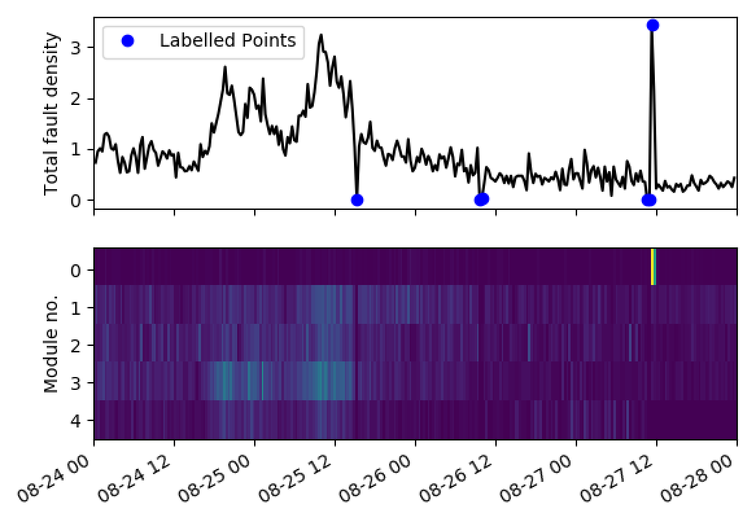
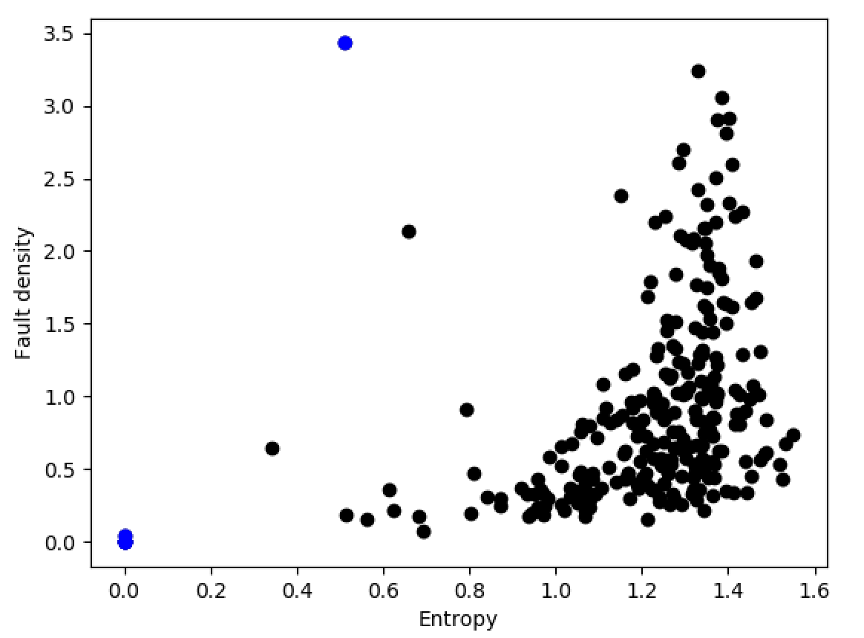
ISRA 5D

Slide 9
ISRA 5D
High fault density but relatively uniform across the ribbon.

Slide 10
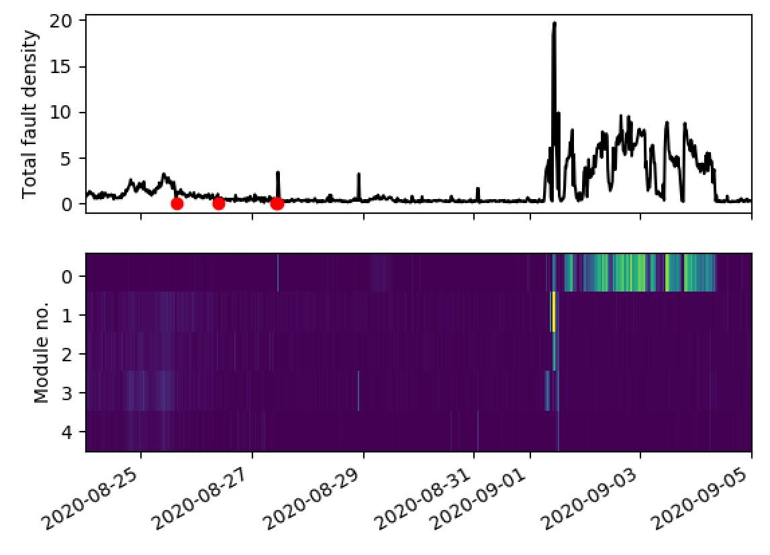
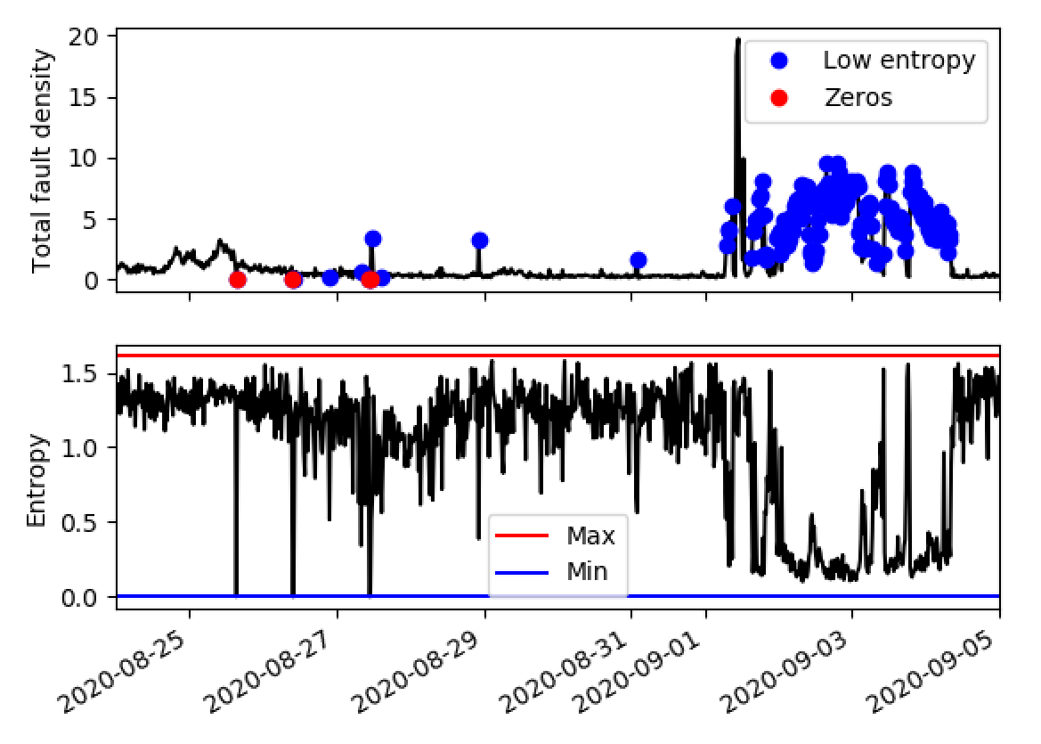
ISRA 5D
Extending the training data to get more labelled points.

Slide 11
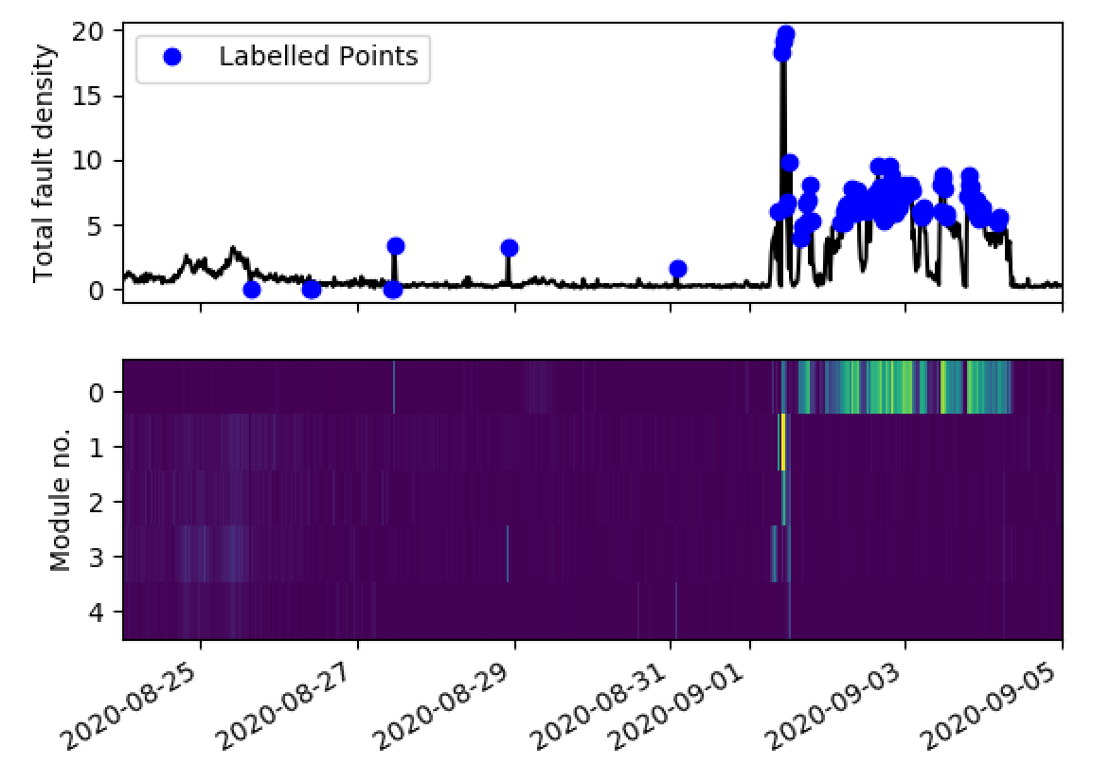
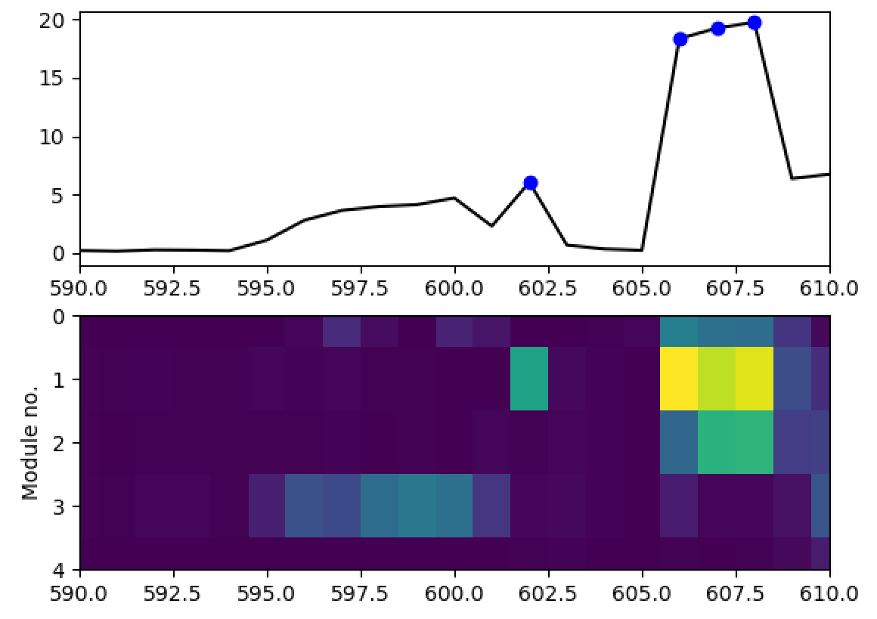
ISRA 5D
Should label?
The labelling can’t get a bit subjective and could probably be improved.

Slide 12
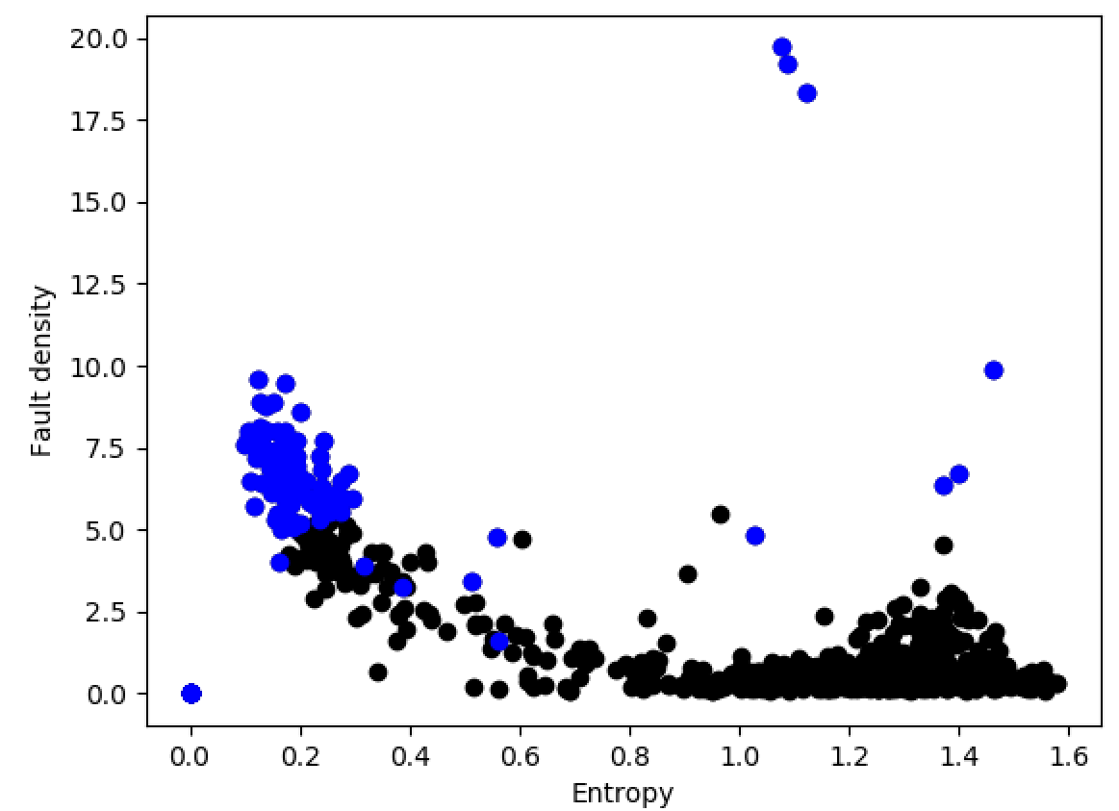
ISRA 5D

Slide 13
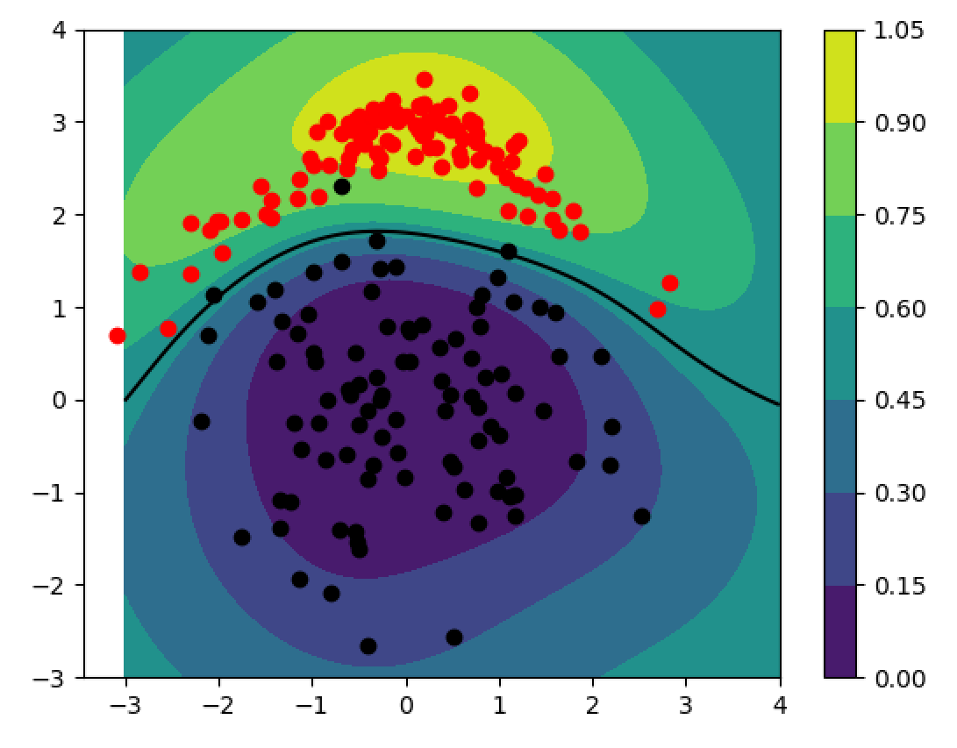
ISRA 5D
We could train a classification algorithm to learn a decision boundary on this plot.
(Example of one of our classification algorithms – a GP in this case.)

Slide 14
ISRA 5D
We could train a classification algorithm to learn a decision boundary on this plot.
But we may as well try something simple first (i.e. a straightforward decision rule).

Slide 15
ISRA 5D
We could train a classification algorithm to learn a decision boundary on this plot.
But we may as well try something simple first (i.e. a straightforward decision rule).
For example, only include if total fault density < 5 and entropy > 0.6.

Slide 16
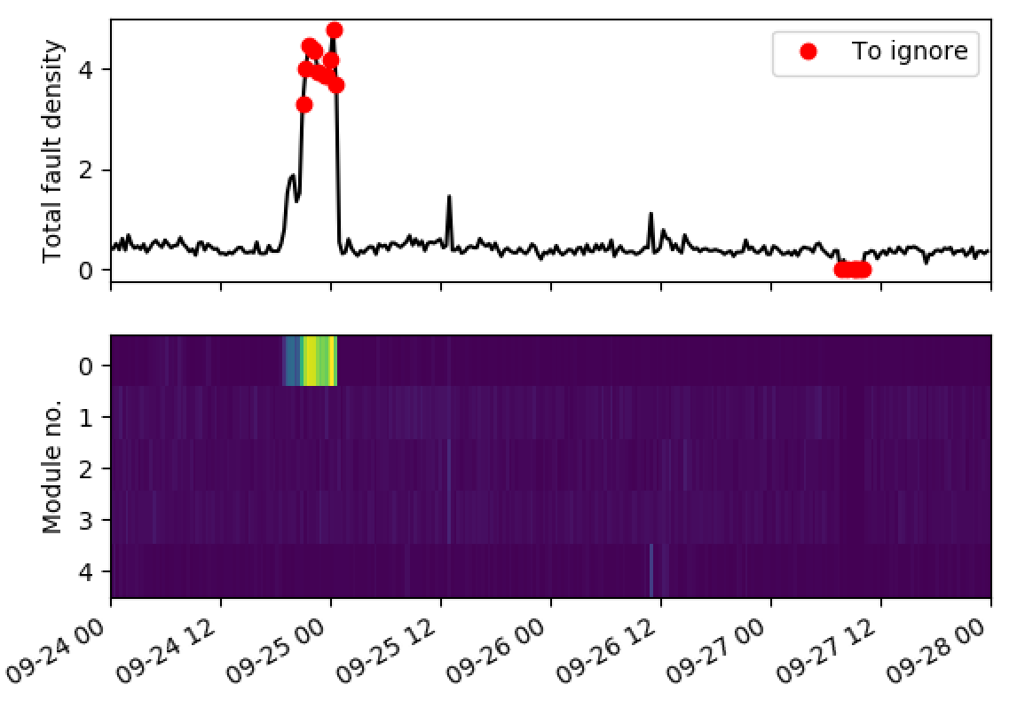
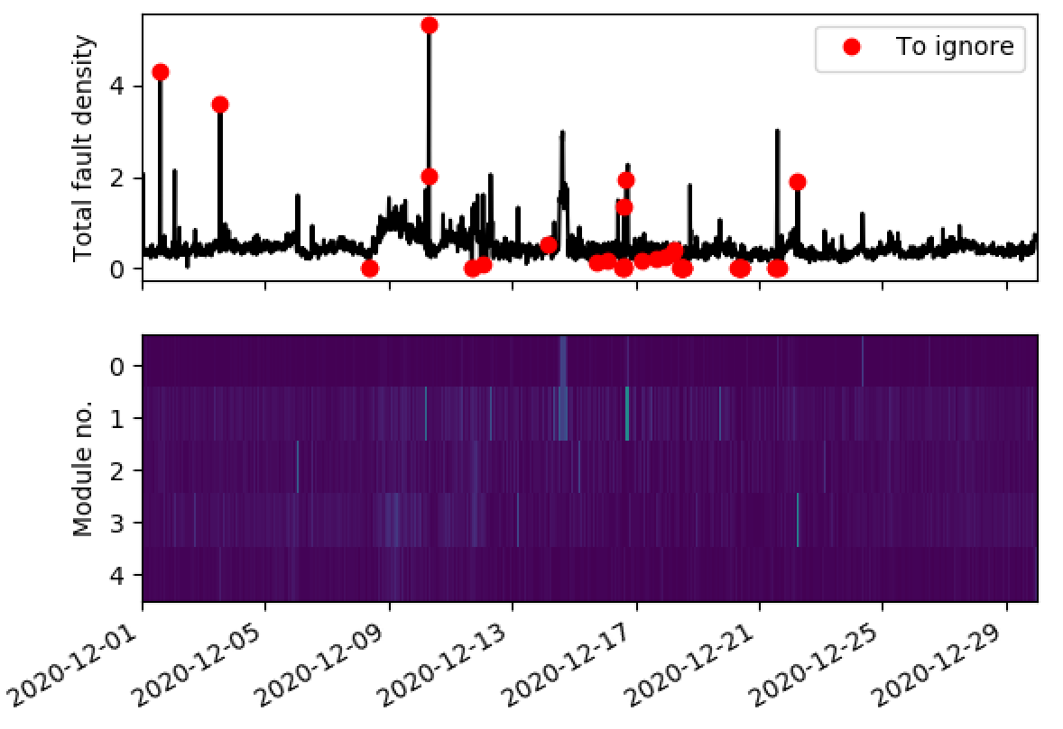
ISRA 5D
Example when applied over two different time periods.

Slide 17
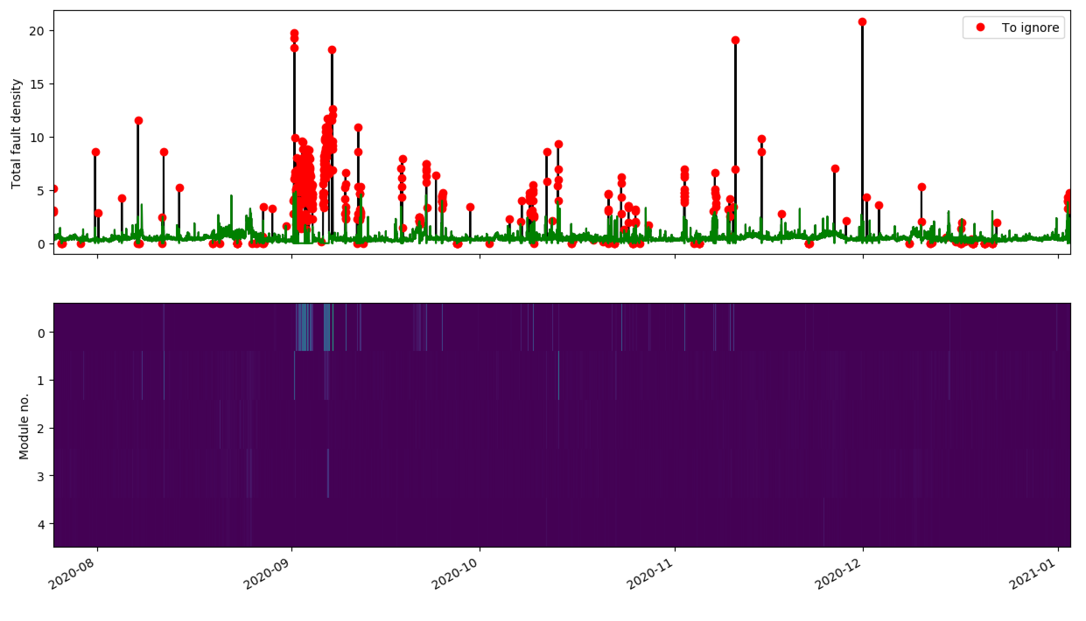
ISRA 5D
July 2020 – Jan 2021.
Here the ‘To ignore’ points are just set equal to zero to create the green line.

Slide 18
ISRA 5D
What is the best way to deal with the red points?
Fault density readings that are equal to (or very close to) zero and have high entropy.
Perhaps replace these with the previous value?
High fault density and low entropy – perhaps we can replace readings from the offending module with the average across the remaining modules?

Slide 19
GP: Relevant input comparison
Inputs | Relevance
10279 Canal Temp. Control (PV) | 1.29692822e+07
2922 Closed Bottom Temperature - Downstream Working End (PV) | 5.90208783e-01
2913 Closed Bottom Temperature - Port 1 (PV) | 1.88644639e+00
2918 Closed Bottom Temperature - Port 6 (PV) | 2.53016657e+00
2921 Closed Bottom Temperature - Upstream Working End (PV) | 4.01497482e+06
1650 Combustion Air Temperature Measurement | 6.70581206e+06
10091 Furnace Load | 1.07234578e+00
15119 Furnace Pressure (PV) | 7.31755158e+00
9393 Glass Level Control (OP) | 8.89175497e+06
7546 Open Crown Temperature - Port 1 (PV) | 1.53359477e+00
7746 Open Crown Temperature - Port 2 (PV) | 2.32852629e+06
7673 Open Crown Temperature - Port 5 (PV) | 7.52222678e+06
7483 Open Crown Temperature - Port 6 (PV) | 1.36922676e+00
10271 Open Crown Temperature - Upstream Refiner (PV) | 1.17411183e+00
7520 Open Crown Temperature - Upstream Working End (PV) | 9.08598670e+06
9400 Port 2 Gas Flow (SP) | 7.60579741e-01
9282 Tweel Position | 4.29270772e+06
11384 Wobbe Index (Incoming Gas) | 5.21612825e+06
Inputs | Relevance
10279 Canal Temp. Control (PV) | 2.32525817e+05
2922 Closed Bottom Temperature - Downstream Working End (PV) | 6.58910088e-01
2913 Closed Bottom Temperature - Port 1 (PV) | 3.21284597e+00
2918 Closed Bottom Temperature - Port 6 (PV) | 4.46250792e+04
2921 Closed Bottom Temperature - Upstream Working End (PV) | 1.04850351e+00
1650 Combustion Air Temperature Measurement | 1.09405581e+05
10091 Furnace Load | 9.76303076e-01
15119 Furnace Pressure (PV) | 1.14024371e+05
9393 Glass Level Control (OP) | 1.65652342e+05
7546 Open Crown Temperature - Port 1 (PV) | 3.09356255e+00
7746 Open Crown Temperature - Port 2 (PV) | 1.39029705e+00
7673 Open Crown Temperature - Port 5 (PV) | 7.64842189e+04
7483 Open Crown Temperature - Port 6 (PV) | 1.28555971e+00
10271 Open Crown Temperature - Upstream Refiner (PV) | 3.78308169e+04
7520 Open Crown Temperature - Upstream Working End (PV) | 1.20256439e+05
9400 Port 2 Gas Flow (SP) | 6.53676451e-01
9282 Tweel Position | 6.73636952e+04
11384 Wobbe Index (Incoming Gas) | 9.33809277e+04

Slide 20
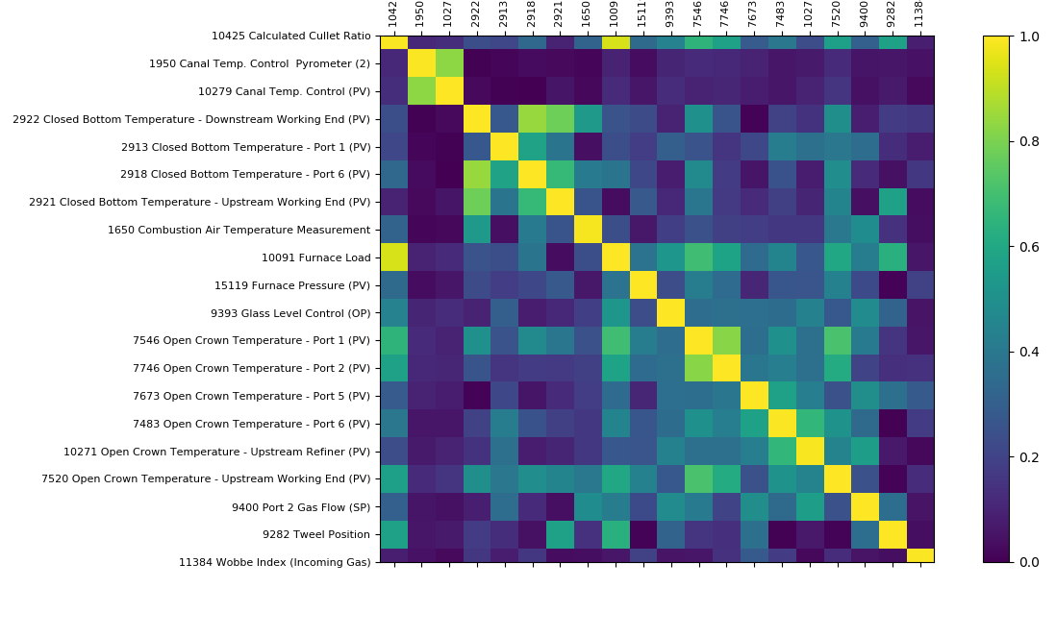
GP: Correlation between main inputs
Absolute values of correlation coefficients indicated using a colour bar varying from 0-1

Slide 21
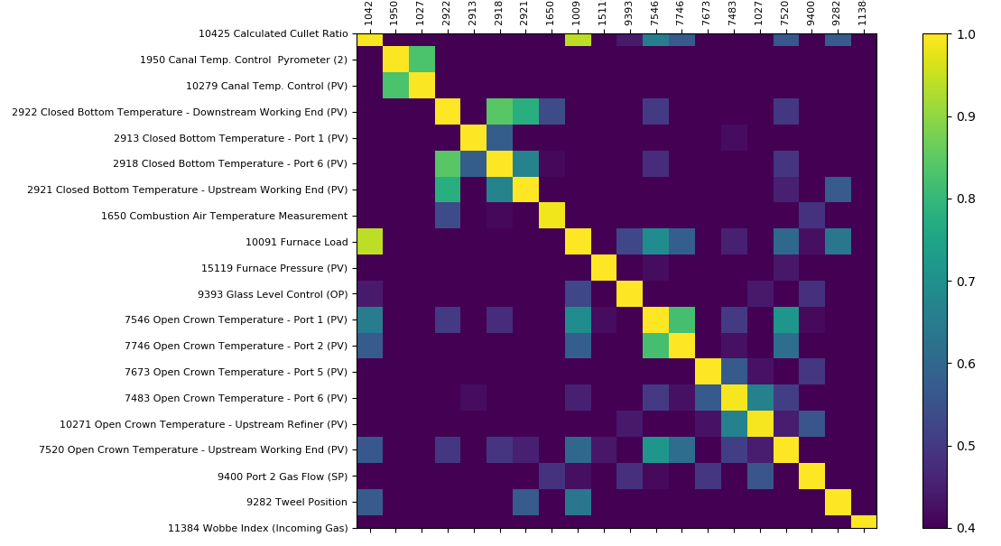
GP: Correlation between main inputs
Threshold = 0.4

Slide 22
GP: Correlation between main inputs
Threshold = 0.4

Slide 23
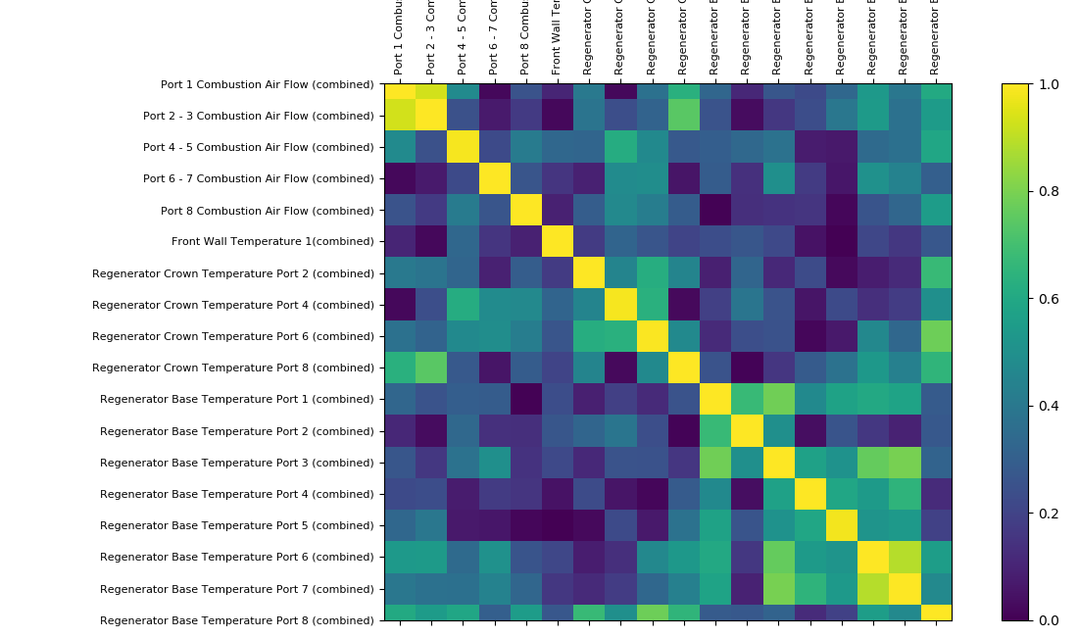
GP: Correlation between combined signals

Slide 24
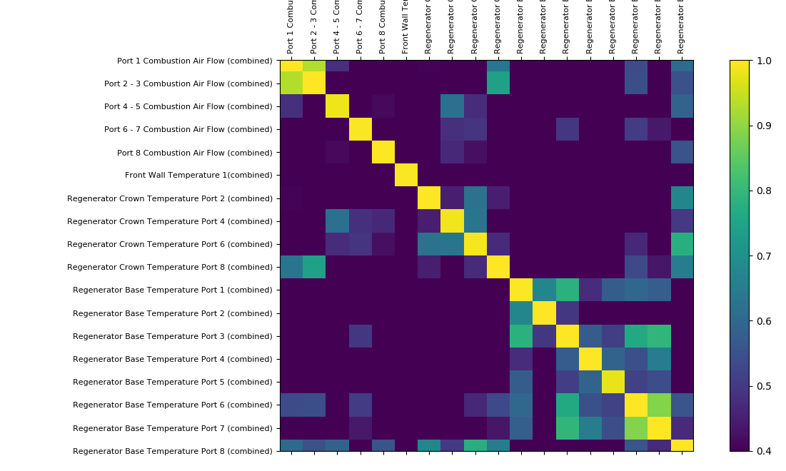
GP: Correlation between combined signals
Threshold = 0.4

Slide 25
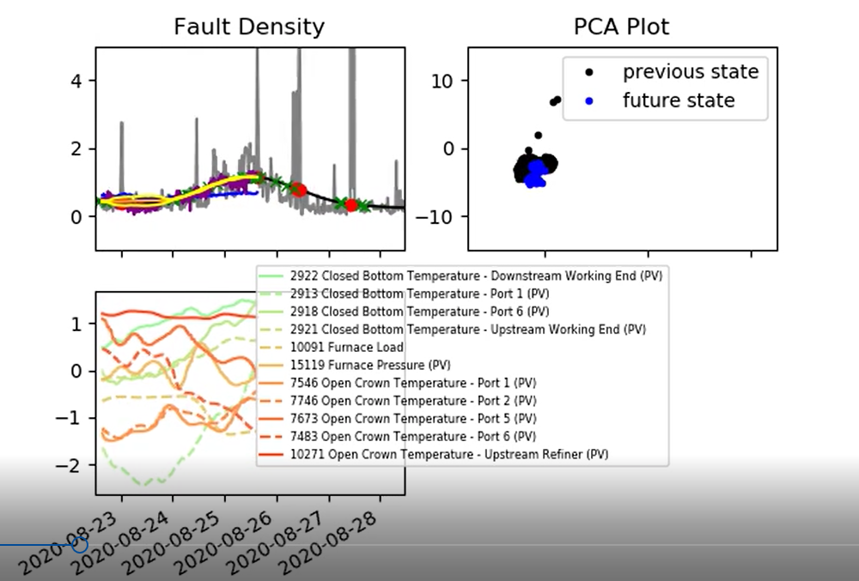
GP: Plotting relevant inputs
Highly relevant inputs identified using GP automatic relevance determination
Identified relevant inputs are quite similar to the inputs identified in previous runs

Slide 26
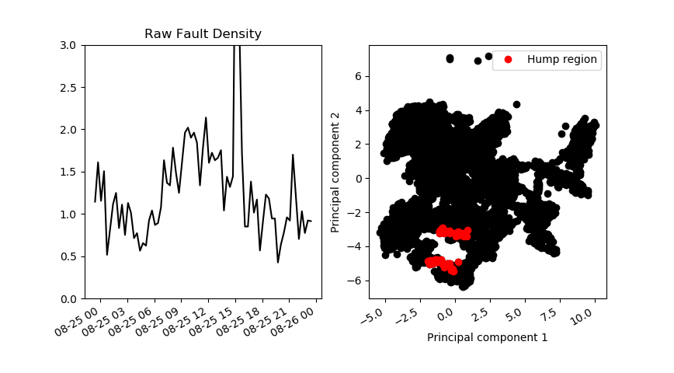
Furnace fault density in the training data

Slide 27
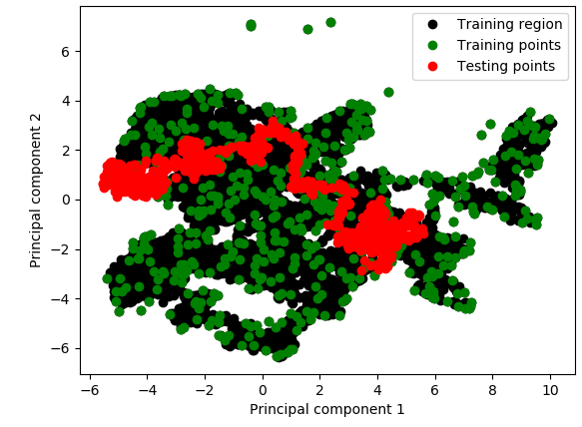
Testing data (18/05/2021 to 28/05/2021)
8
7
6
Day | From | To
1 | 18/05/2021 | 19/05/2021
2 | 19/05/2021 | 20/05/2021
3 | 20/05/2021 | 21/05/2021
4 | 21/05/2021 | 22/05/2021
5 | 23/05/2021 | 24/05/2021
6 | 24/05/2021 | 25/05/2021
7 | 25/05/2021 | 26/05/2021
8 | 26/05/2021 | 27/05/2021
Day | From | To
1 | 18/05/2021 | 19/05/2021
2 | 19/05/2021 | 20/05/2021
3 | 20/05/2021 | 21/05/2021
4 | 21/05/2021 | 22/05/2021
5 | 23/05/2021 | 24/05/2021
6 | 24/05/2021 | 25/05/2021
7 | 25/05/2021 | 26/05/2021
8 | 26/05/2021 | 27/05/2021
9 | 27/05/2021 | 28/05/2021
10
5
Day | From | To
1 | 18/05/2021 | 19/05/2021
2 | 19/05/2021 | 20/05/2021
3 | 20/05/2021 | 21/05/2021
4 | 21/05/2021 | 22/05/2021
5 | 22/05/2021 | 23/05/2021
6 | 23/05/2021 | 24/05/2021
7 | 24/05/2021 | 25/05/2021
8 | 25/05/2021 | 26/05/2021
9 | 26/05/2021 | 27/05/2021
10 | 27/05/2021 | 28/05/2021
4

Slide 28
Controlled and Manipulated variables
MV – Manipulated Variables. These are manually controlled variables directly available to suggestive tool.
MV (Indirect) – These are manipulated variables, but indirectly controlled by an existing PID controller. For example, port combustion air flows.
CV (Auto) – These are controlled variables as part of existing PID control loops. These may be available to the suggestive tool for setpoint adjustments. For example, canal temperature.
CV – Controlled Variables. These are the furnace variables that will be affected because of a change of MV, MV (Indirect), CV (Auto) and UV.
UV – Uncontrolled Variables. These are input variables we have little or no influence over. For example, wind speed.

Slide 29
Controlled and Manipulated variables
MV – Manipulated Variables. These are manually controlled variables directly available to suggestive tool.
We only have 2, Calculated Cullet Ratio and Port 2 Gas Flow
MV (Indirect) – These are manipulated variables, but indirectly controlled by an existing PID controller. For example, port combustion air flows.
CV (Auto) – These are controlled variables as part of existing PID control loops. These may be available to the suggestive tool for setpoint adjustments. For example, canal temperature.
CV – Controlled Variables. These are the furnace variables that will be affected because of a change of MV, MV (Indirect), CV (Auto) and UV.
UV – Uncontrolled Variables. These are input variables we have little or no influence over. For example, wind speed.

Slide 30
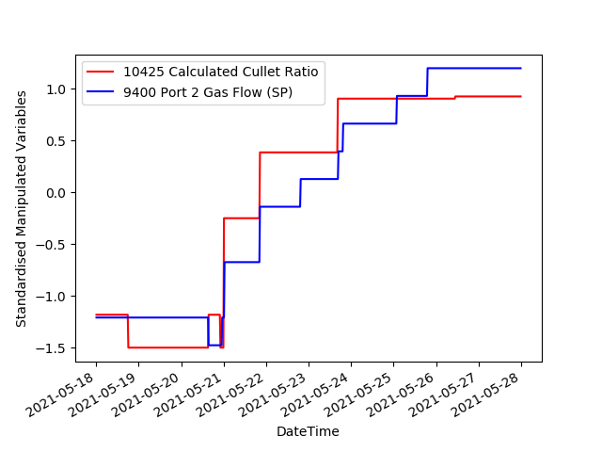
Manipulated variables
Time-lags:
10425 Calculated Cullet Ratio = 24h
9400 Port 2 Gas Flow (SP) = 24h

Slide 31
Manipulated variables
Time-lags:
10425 Calculated Cullet Ratio = 24h
9400 Port 2 Gas Flow (SP) = 24h
Zoom in

Slide 32
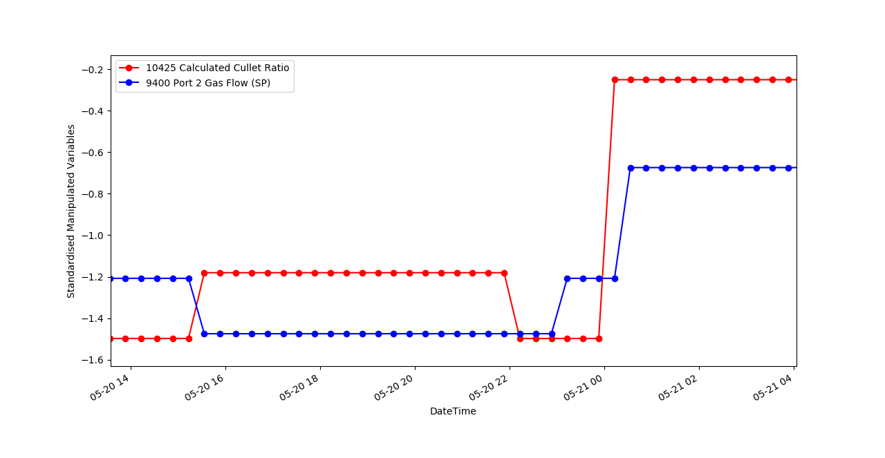
Manipulated variables

Slide 33
Varying: Calculated Cullet Ratio and Port 2 Gas Flow (SP)
MV – Manipulated Variables. These are manually controlled variables directly available to suggestive tool.
MV (Indirect) – These are manipulated variables, but indirectly controlled by an existing PID controller. For example, port combustion air flows.
CV (Auto) – These are controlled variables as part of existing PID control loops. These may be available to the suggestive tool for setpoint adjustments. For example, canal temperature.
CV – Controlled Variables. These are the furnace variables that will be affected because of a change of MV, MV (Indirect), CV (Auto) and UV.
UV – Uncontrolled Variables. These are input variables we have little or no influence over. For example, wind speed.
Assuming the MV(indirect), CV(Auto), CV and UV tags remain constant, we randomly vary the Calculated Cullet Ratio and Port 2 Gas Flow using the last day of data that is outside a known furnace state (From 2021-05-27 to 2021-05-28).

Slide 34
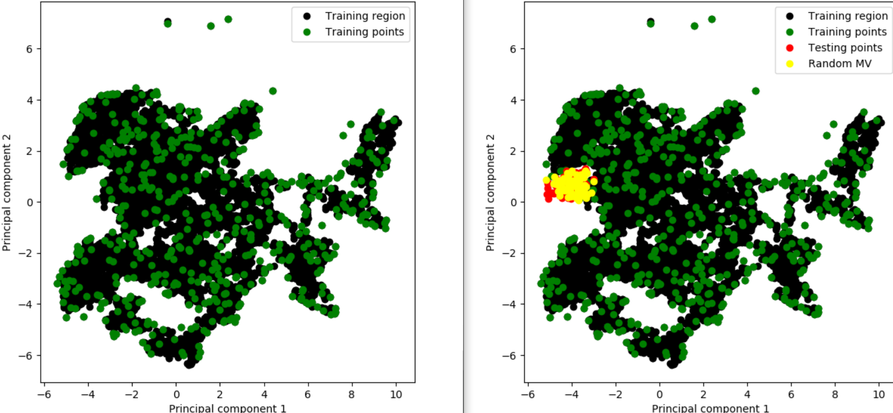
Varying: Calculated Cullet Ratio and Port 2 Gas Flow (SP)

Slide 35
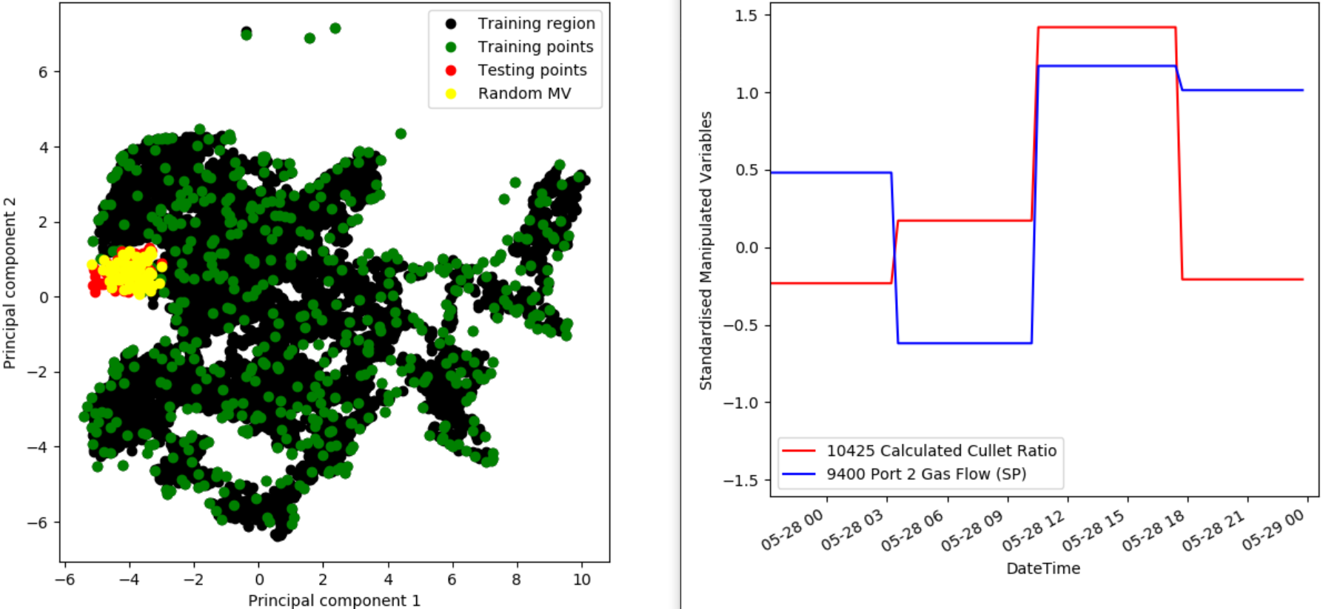
Varying: Calculated Cullet Ratio and Port 2 Gas Flow (SP)

Slide 36
Thank you for your attention. ANY QUESTIONS?

